Slide 1
Introductory General Chemistry
Chemistry 3A
Experiment 7a
Calorimetry
Mitch Halloran

Slide 2

Introduction
Calorimetry means the measurement of heat. This measurement is of heat energy either given off (exothermic) or absorbed (endothermic) by the system from the surroundings
Heat is measured by temperature changes with a thermometer and utilizes the specific heat capacity equation:
$$q=m ×c × ∆T$$
Symbol | Meaning | Units
q | energy as/in the form of heat | J or cal
m | mass of the substance in the system | g
c | specific heat capacity of substance: this is a physical property determined by scientists doing experiments | J / (g °C)
ΔT | change in temperature in °C: this is the final temperature minus the initial temperature | °C

Slide 3
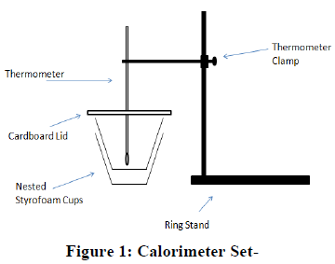
Background: Part 1
When a solid is dissolved in a liquid (solvent), there can be an energy change related to the molecules of the solid interacting with the molecules of the solvent.
When heat is released in dissolving, reaction is exothermic
When heat is absorbed in dissolving, reaction is endothermic

Slide 4
Background: Part 2
Objects with different temperatures in contact with each other, heat from the warmer object transfers to the cooler object until both reach same temperature.
Since energy is conserved, if H₂O as ice is put in contact with H₂O as water, it should be possible to measure temperature changes in the water as ice melts to see if this law is observed

Slide 5

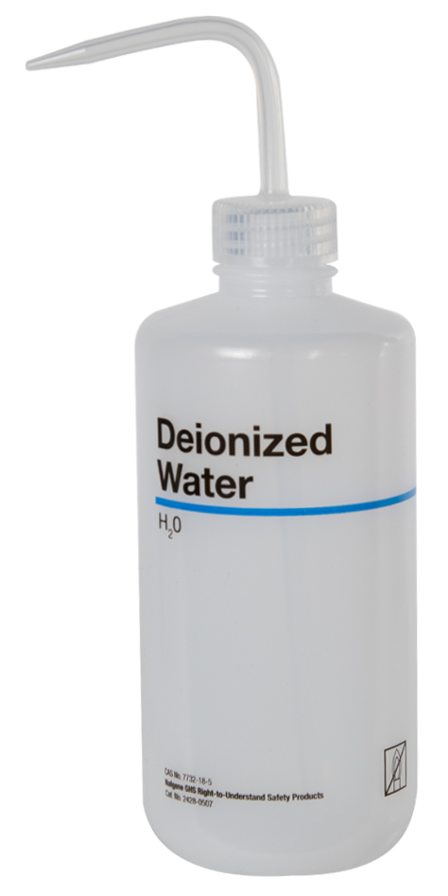
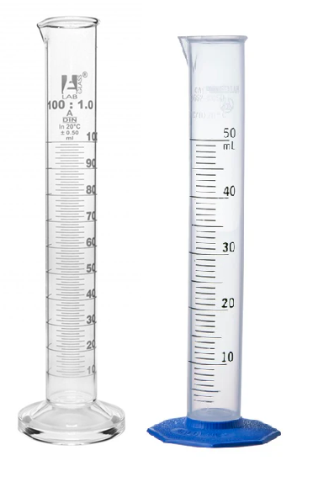
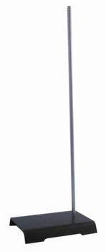
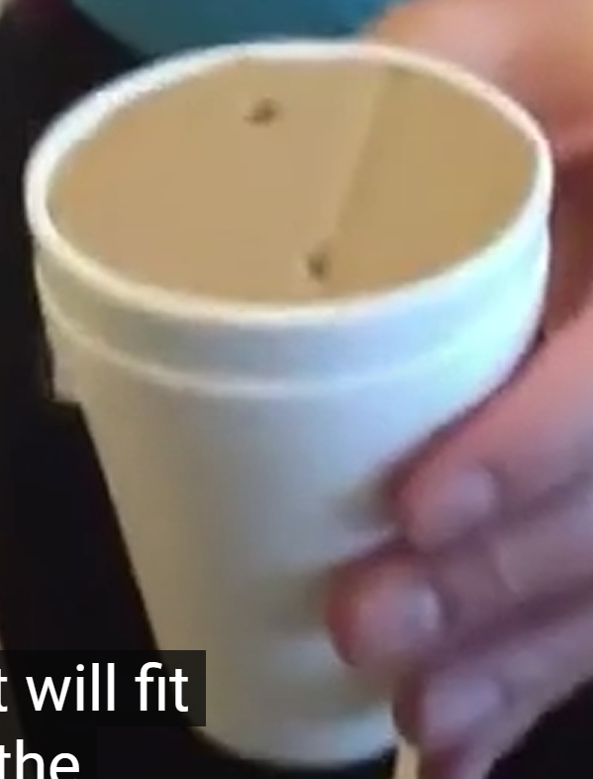
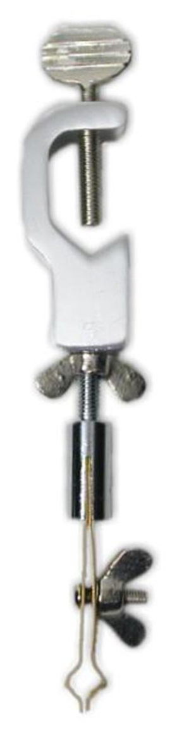
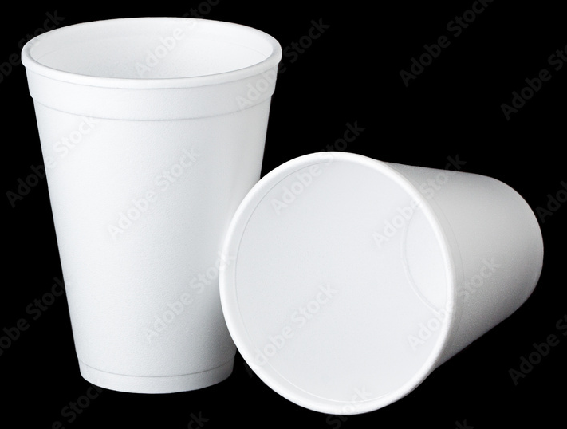
Equipment You Will Use

Slide 6
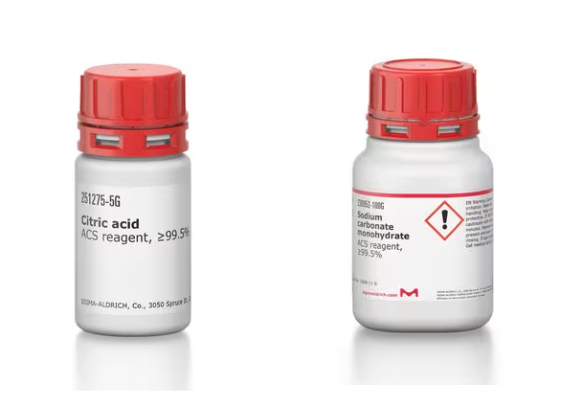
Consumables

Slide 7
Procedure: Part 1
Construct the calorimetry setup with the foam cups
Measure the mass of the cups ONLY
Add 45.0 to 55.0 mL DI water to grad cylinder & pour into cups
Record temperature to nearest 0.1°C
On glassine paper, scoop out 4.8-5.2 g citric acid without causing excessive waste. Tighten the reagent lid after.
Add citric acid carefully but quickly to the calorimeter with water and place lid on setup; VERY CAREFULLY with lid closed stir the solution until solid dissolves

Slide 8
Procedure: Part 1
Record temperature to nearest 0.1°C after it stabilizes (it might go up or down)
Remove the cardboard lid. Record the mass of the calorimeter setup: cups + solution
Empty the solution into a beaker (for waste) then rinse and dry the inner cup
Switch the inner cup with outer cup
Repeat steps 3-8 with sodium carbonate (Na₂CO₃)
Pour out the waste into the beaker, discard the solution into the sink

Slide 9
Procedure: Part 2
Construct the calorimetry setup with the foam cups and add 45.0-55.0 mL DI water
Measure the mass of calorimeter with water without lid
Record temperature to nearest 0.1°C
Transfer 2-3 cubes ice to calorimeter
Place lid and stir carefully with thermometer until ice melts. Record the final temperature
Record mass of calorimeter with contents (not lid)

Slide 10
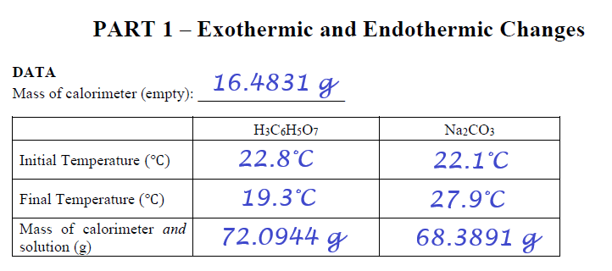
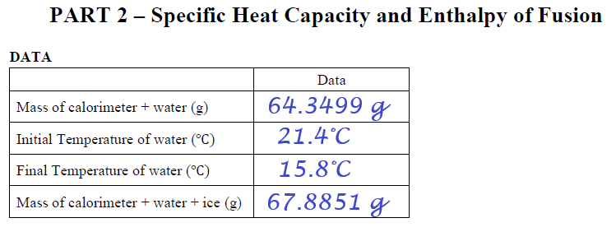
Example Data Analysis

Slide 11
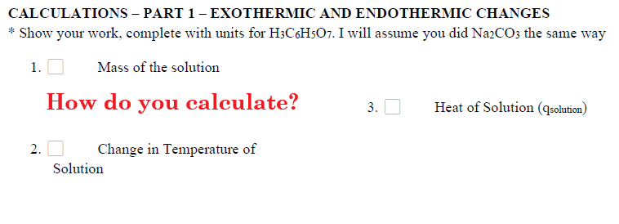
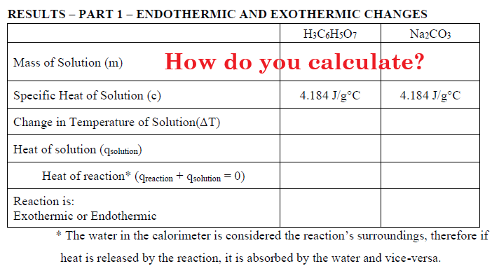
Example Data Analysis

Slide 12
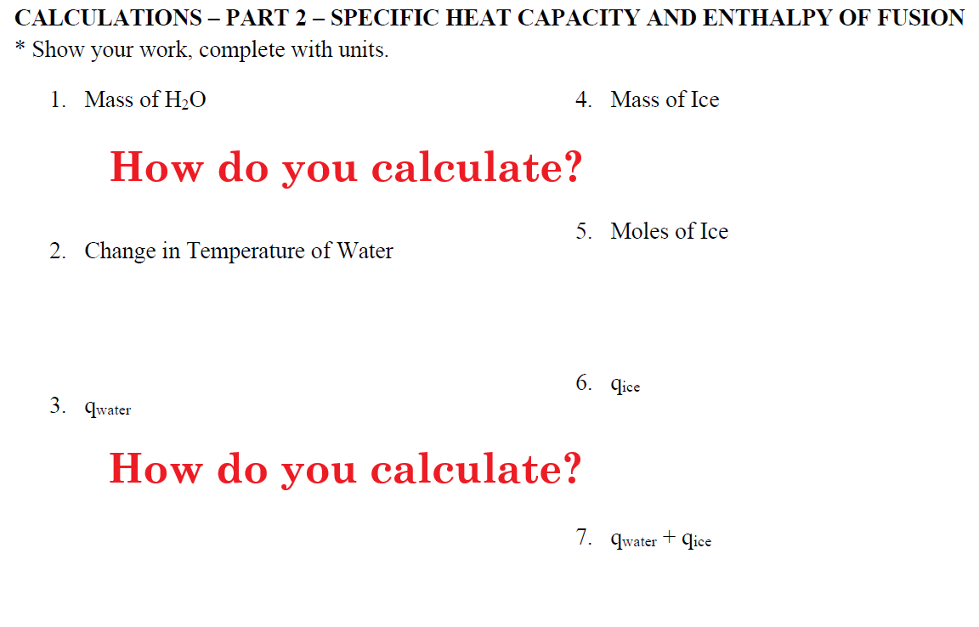
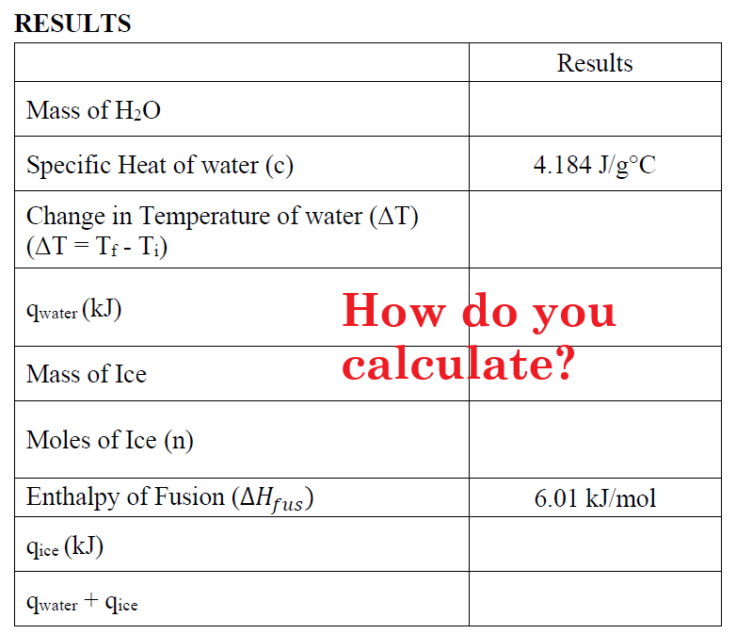
Example Data Analysis

Slide 13
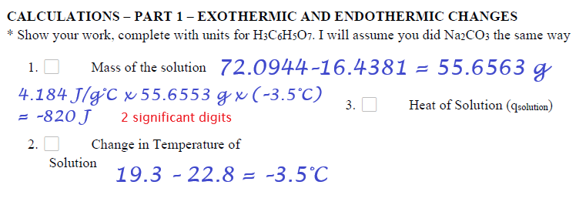
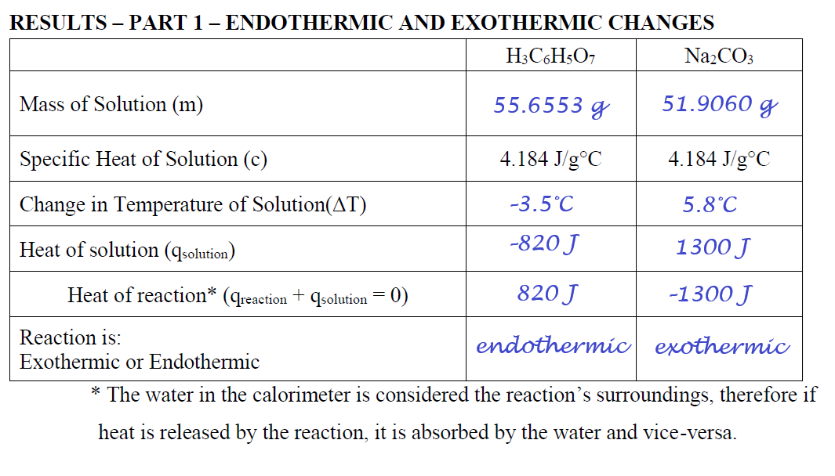
Example Data Analysis

Slide 14
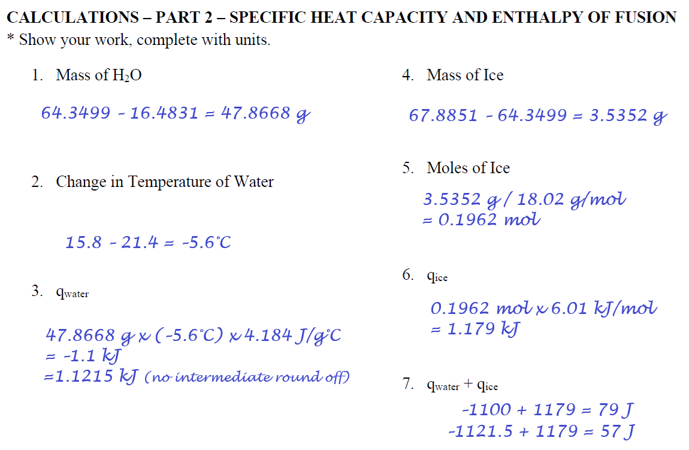
Example Data Analysis

Slide 15
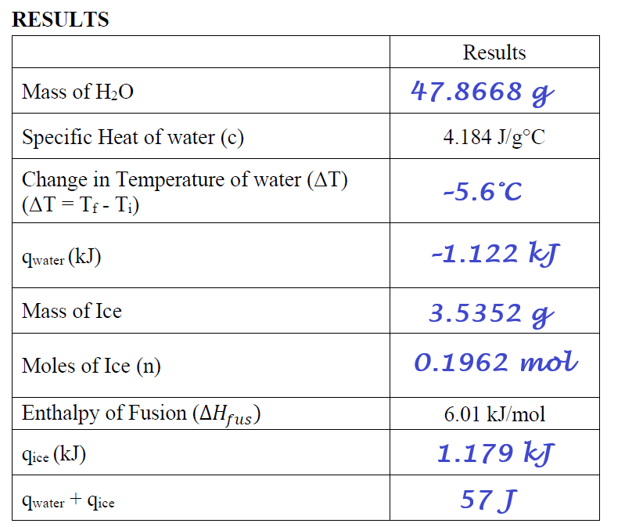
Example Data Analysis

Slide 16
Clean Up
Return equipment cleaned if necessary to its storage areas
Return cardboard lid to supply bin
Discard the Styrofoam cups

